Slide 1

ENPM 662 - PROJECT 1
SLIDING MODE CONTROL BASED ON BACKSTEPPING
Approach for an UAV Type-Quadrotor
BHAVANA B RAO
SRIRAM PRASAD KOTHAPALLI

Slide 2
TABLE OF CONTENTS
01
05
INTRODUCTION
OPTIMIZATION
02
06
QUADROTOR DYNAMICS
SIMULATION RESULTS
03
07
STATE SPACE EQUATIONS
SIMULATION VIDEO
04
SLIDING MODE CONTROL

Slide 3
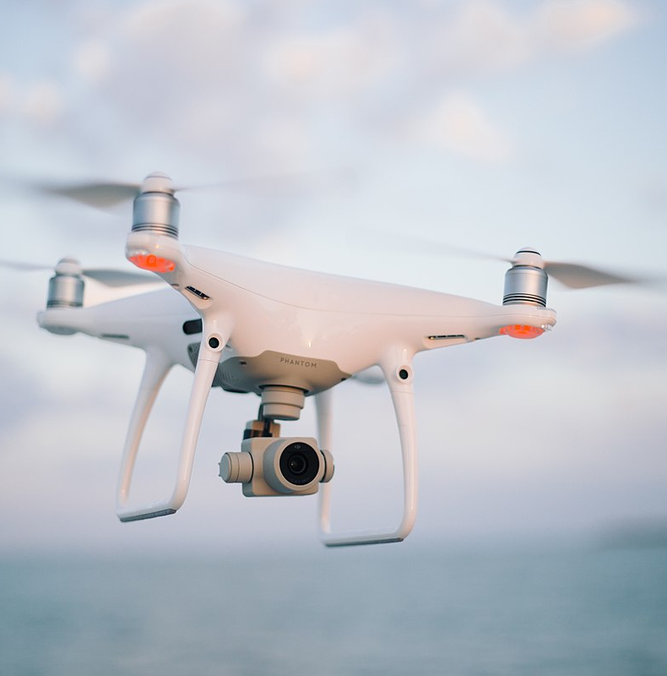
INTRODUCTION
This presentation aims to unravel the complexities of quadrotor dynamics and showcase the application of sliding mode control for precise tracking.
Focus:
Quadrotor Dynamics
State-Space Equation
Sliding Mode Controller: Development through the backstepping approach.

Slide 4
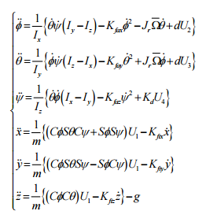
QUADROTOR DYNAMICS
The quadrotor dynamic equations are obtained making the following assumptions:
The quadrotor frame is both rigid and symmetrical.
The center of mass aligns with origin.
The propellers maintain rigidity.
The thrust and drag exhibit a proportional relationship to the square of the propeller speed.

Slide 5
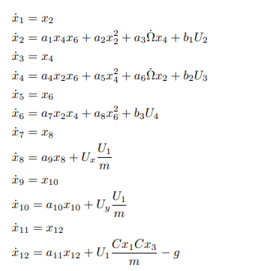
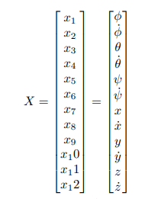
STATE SPACE EQUATIONS
The dynamic equations are converted to the following state space equation,
The state space vector is considered to be,

Slide 6
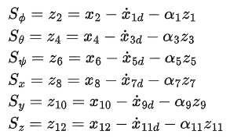
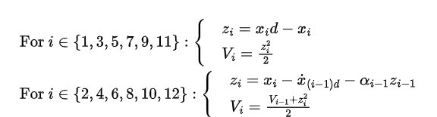
SLIDING MODE CONTROL
The sliding mode control algorithm shown in the image is a recursive backstepping algorithm. Recursive backstepping is a method for designing sliding mode controllers for systems with multiple degrees of freedom.

Slide 7
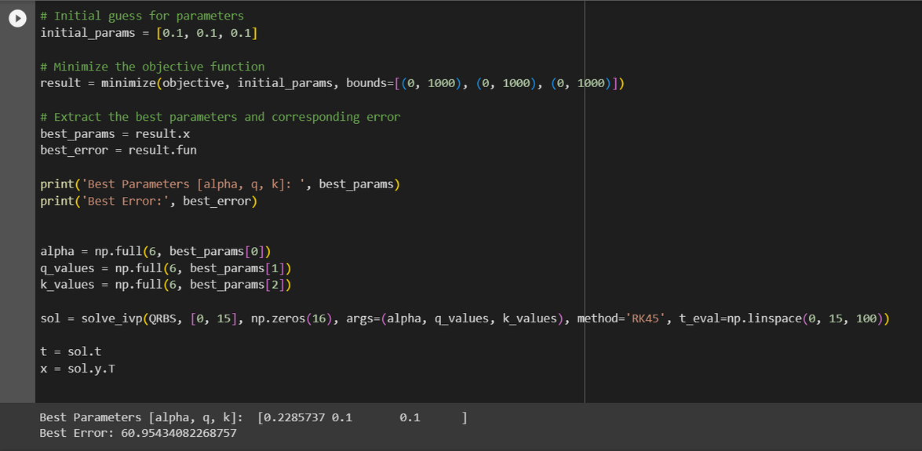
OPTIMIZATION
The control gains (ki and qi), alpha defined in the sliding mode control are optimized using minimize function of SciPy library to obtain the values corresponding to the best value.
Alpha = 0.2285737
q = 0.1
k = 0.1

Slide 8
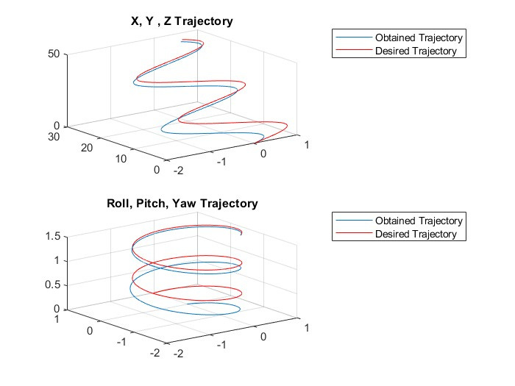
SIMULATION RESULTS
As the trajectory considered in the paper is unknown, we assume
x = sin(t)
y = 2*t
z = 3*t
roll = sin(t)
pitch = cos(t)
yaw = 0.1*t
As expected, the desired and obtained trajectories converge and the error decreases with time.

Slide 9
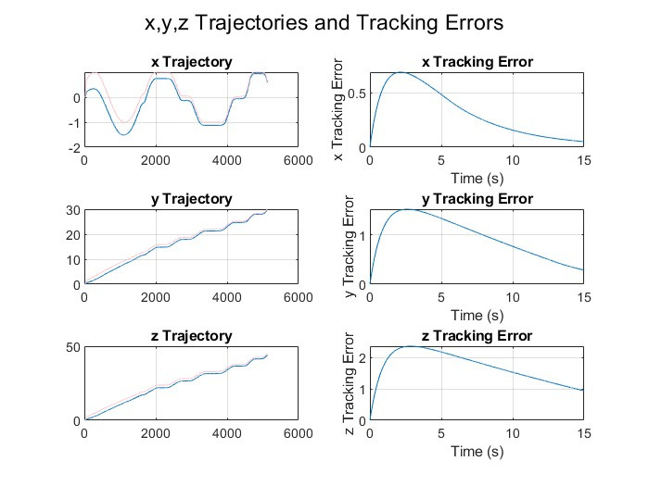
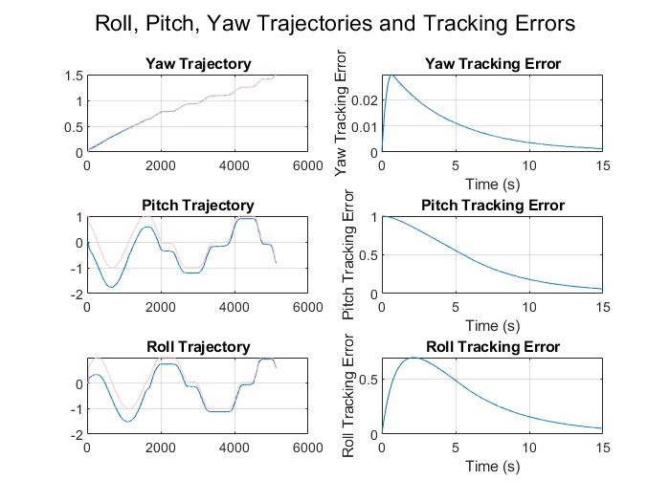
SIMULATION RESULTS
Trajectories in all directions (translational and rotational) with their respective tracking errors are as shown in the figures above.

Slide 10
SIMULATION VIDEO
https://drive.google.com/drive/folders/12ATNqV_yzvZZ2GJN9c-3UweORJlUUBra?usp=sharing
The above link contains the video of MATLAB simulation to obtain the plots shown in the slides before. The Python simulation contains the optimization of parameters.

